Slide 1
An Engine to Drive High Performance
Accenture Life Insurance Platform
Solution Deck

Slide 2
Usage Guidelines
This deck is designed for presentations to C-level executives in life insurance companies. Its aim is to address high-level business imperatives, and then introduce the Accenture Life Insurance Platform as part of a comprehensive solution.
The deck can be customized by selecting the slides that are most pertinent to the level of the discussion, the time available, and the interests of the audience.
Points of contact:
Albert Juanals is the EALA Accenture Software for Insurance Sales Lead. Based in Barcelona, he can be contacted on +34 93-227-1227.
Nicole Michaels is the North America Accenture Software for Insurance Sales Lead. Based in Minneapolis, she can be contacted on +1 612-277-5065.
Glenn Rogers is the APAC Accenture Software for Insurance Sales Lead. Based in Melbourne, he can be contacted on +61 39838 8355.
Gilles Biscay is the Accenture Software for Insurance Global Managing Director. Based in Paris, he can be contacted on +33 607 281265.

Slide 3
Executive Summary
Current market conditions provide an opportunity for insurers to take stock of and improve processes and operations to ensure that they have the flexibility and resources needed to take full advantage of the opportunities that will be present when the market starts to turn.
Savvy insurers know that policy administration is an area of great opportunity to reduce costs, support growth through quicker speed-to-market, improve customer service, and restructure for competitive advantage.
Administrative optimization is often seen as being difficult due to complexity of insurance products, inflexibility of legacy systems, resource constraints, intricacy of system integration, and resistance to change. Serious considerations that can be addressed with the right partner. To successfully optimize administrative operations, you need a holistic approach:
A market-leading policy administration software system;
A partner that possesses a deep understanding of insurance processing, with comprehensive implementation, integration, change management & support capabilities.
Accenture Life Insurance Platform is the leading policy administration system for life insurers:
Our proven solution, Accenture Life Insurance Platform, has a 15+ year track record that is complemented by an unequalled process improvement, implementation, integration, delivery & support capability. Currently serving:
ALIP has a 100% production success rate with over 50 life and annuity companies.
90% of the top life and annuity insurers in North America use the Accenture Life Insurance Platform.
Accenture provides Life administration solutions to 10 of 15 major Italian companies, representing 30% of life premiums.

Slide 4
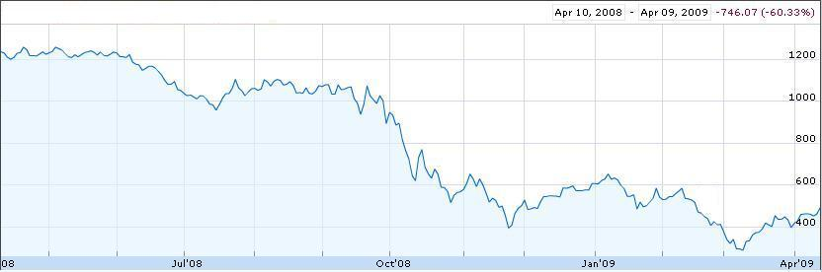
Market Trends Insurers’ share prices have plummeted
Share price movement: Best’s Global Life Insurance Index
April 2008 – April 2009
Loss of shareholder equity, combined with an unprecedented drain on surplus due to devastating investment returns, threatens even the strongest insurers.
Source: Google Finance, Best’s Global Life Insurance Index

Slide 5
Strategic initiatives (1/4) The market downturn requires a strategic focus on five business imperatives
Investment / Financial Risk Management | Underwriting / Liability Risk Management | Cost Reduction/ Operational Excellence | New Organic Growth | Inorganic Growth Opportunities
Improved risk management, shift to safer investments More standardized financial reporting | Low interest rates intensify the need for underwriting excellence Focus on underwriting profitability | Investment losses Softer demand Price resistance | Impact of stock volatility on demand for savings products Tougher competition in a receding market Need to be quicker to market with better products | Companies vulnerable: low stock prices, short of capital Good growth potential in new geographies
Typical Initiatives Create comprehensive operational risk management framework & related solutions Implement a reliable & standard finance management capability | Typical Initiatives Deploy proven, competitive & optimally profitable underwriting practices across the organization | Typical Initiatives Strategic cost reduction Optimized sourcing Operating model integration Sales & service optimization Automation, operational flexibility, IT rationalization | Typical Initiatives Improve collaboration in bringing new products to market Introduce a ‘product factory’ capability Enable agent & customer self service using new sales channels | Typical Initiatives Create acquisition engine For major mergers & acquisitions secure cost & revenue synergies in under 12 months
© 2010 Accenture All Rights Reserved.
5

Slide 6
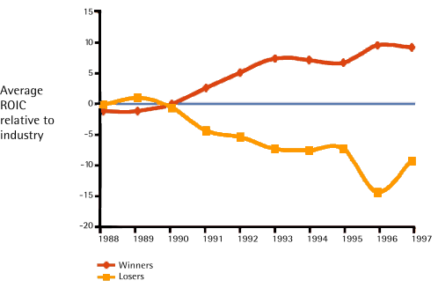
Strategic initiatives (2/4) Winners take advantage of downturns to improve their strategic position
Key Questions
Performance Comparison Post 1990-1991 Slump
What are you doing to raise performance & improve your competitive position during this downturn?
What changes have you made to optimize capital allocation?
What have you done to reduce costs in your operation?
Is service improvement a priority, and does it conflict with your cost goals?
What are you doing to offset the constant demand for skilled resources?
Are you taking full advantage of available insurance technology & expertise?
Winners Pull Away After a Recession*
*Winners are those that outperformed others in their industry for the six years following the recession of 1990-1991; losers are those that under-performed others in the industry
Notes:
Time: 1 minute
Content Review Point: Typically, Life Insurance prices are based on an individual’s overall health and age.
Content Review Point: Both P&C and Life insurers price their products before the actual cost is known based on two factors: historical results and risk factors.
Content Review Point: Underwriting is the biggest value lever for both P&C and Life insurers.
Content Review Point: Life insurers’ profitability is also tied heavily to economic conditions.

Slide 7
Strategic initiatives (3/4) Policy Administration represents a significant opportunity to create value, differentiation and market leadership
The opportunity…
…challenges addressed
Unlock value in the policy administration
process:
1. Operational cost reduction
Through:
Standard, industrialized processes
Automated processes
“Lower Touch” environment
2. Client retention
Through tailor-made levels of service, allowing customer service to be a differentiator rather than a cost center
3. Higher compliance
Repeatable, controlled processes that use the individual profile of each policy or product to generate the appropriate workflow
1. Oversimplification
Life and annuity administration is very technical, with complex workflows and procedures
Oversimplifying the problem results in overruns and lower ROI
Implementation project must be adequately staffed with experienced insurance software professionals
2. Resistance to change
Large, complex organizations are difficult to change
Change management journey requires a lot of attention
3. System integration
Core insurance systems are complex and intricately connected to other systems
Integration is always an issue
Notes:
7

Slide 8
Strategic initiatives (4/4) High performers are changing key features of their operations
From:
To:
Relying on individuals’ expertise
By putting complex cases in front of them
Applying collective knowledge to every case
Building knowledge into systems & job aids
Capturing applications rapidly and handing off
Handle high volume with low cost
Focusing on excellence throughout the new business process
The customer service ‘moment of truth’
Handing the file on to the next expert
Linear routing of administrative tasks
Getting the right tasks to the right people, in parallel
Segmentation of underwriting cases and specialization of teams/individuals can be hugely powerful
Working around system constraints to save costs
Because changing systems is expensive
Focusing manual effort on the valuable activities
By using systems that are more readily configurable
Information locked in legacy systems
Because it is tough to extract data and the systems can’t store it in an accessible form
Capturing & applying enterprise policy information
Use new generation systems to capture and present data, enabling tuning of core functions
Notes:
8

Slide 9
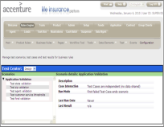
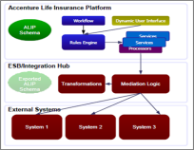
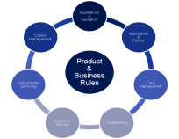
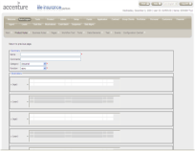
Our Value Propositions (1/4) Serving Global Market Needs
The Accenture Life Insurance Platform allows our clients to achieve success across a wide variety of value propositions
A single ALIP front end across all deployed components of the system
Client configurable to support needs by distribution channel, line of business, etc.
An integration architecture that allows for plug and play connectivity to 3rd party components
Front multiple legacy administration systems, allowing the costs of consolidation to be spread out over time
Leverage ALIP for new product introduction, servicing existing business on existing platforms
Multiple models of component deployment to support both turn-key and custom customer requirements
All components of the platform leverage a consistent set of product and business rules
Comprehensive tools for the configuration to support business and product requirements
Fully support a global insurance product catalog using insurance engines designed for the task
Using a common user interface
Driven by commonly managed configuration of tables, calculations, and rules
Front End
Integration Architecture
Component Deployment
Configuration Factory

Slide 10
Our Value Propositions (2/4) The Accenture Life Insurance Platform is backed by our insurance experience & expertise – together delivering a total solution
Global Insurance Practice
A market-leading Policy Administration solution
Insurance systems expertise & experience
30+ years of industry experience
10,000 insurance practitioners
Deep industry knowledge & systems integration experience
Deployable assets in claims, policy, underwriting, product manufacturing, marketing & distribution, finance & accounting
Track Record of Innovation
Inventive software – 3 patents + 35 pending
Continuous process innovation arising out of deep industry experience & process expertise, and synergistic collaboration between different specialist groups
Innovative contracting
Seamless Global Delivery
Global Delivery Center Network with 24x7 access worldwide
CMM Level 5 implementation capabilities
60,000+ professionals
IT & outsourcing solutions
Standard, proprietary & rigid methodologies, tools, architectures, estimations & metrics
100+ alliance partnerships
Differentiated Vendor Approach
Whole range of Life Consolidation services, global approach and superior tools to identify, design and implement solutions to meet clients’ business objectives
Accenture Software is a strategic structure in charge of driving R&D investments, ongoing developments and support of assets.
300+ ALIP strategy, design and engineering professionals
A Committed, Long-Term Partner
Able to provide a comprehensive solution
Willing to share risk & reward
Financial durability

Slide 11
Our Value Propositions (3/4) The Accenture Life Insurance Platform has been consistently recognized by industry analysts as a market leader
Proven Implementation
Industry Credentials
Market Leadership
Accenture has been providing advanced technology solutions and professional services to the life insurance market for over 23 years.
ALIP has a 100% production success rate with over 50 life and annuity companies.
90% of the top life insurance and annuity providers in North America are ALIP customers.
Accenture provides Life administration solutions to 10 of 15 major Italian companies, representing 30% of life premiums.
ALIP has been utilized by multi-national insurance clients internationally since 2001.
“ALIP is a modern, flexible, and powerful solution that should be considered by insurers that are trying to optimize their underwriting capabilities while speeding decision time and reducing costs.” Accenture won Celent’s 2010 XCelent Functionality Award and XCelent Customer Award.
(Celent, 2010/11, “North American Life Insurance New Business and Underwriting Systems”)
ALIP received a ‘Positive’ rating. “Perhaps the most forward-thinking of all the policy administration vendors”.
(Gartner Group, 2010/06, “Market Scope for North American Life Insurance Policy Administration Vendors”)
“A strong client base worldwide and a solution that has proven its ability to meet insurers business requirements in different geographies. However, Celent believes that the best of ALIP is still to come.”
(Celent, 2009/09, “European Policy Administration Systems 2009”)
“ALIP received an ‘Excellent’ product viability rating with one of highest overall score out of 6 policy admin vendors”
(Gartner Group, 2008/09, “Critical Capabilities for European Life Insurance Policy Administration Systems”).
Accenture’s Insurance Data Migration Factory (IDMF)
Dozens of conversions totaling over 30 million policies
Industrialized tools and process for designing, building, executing and validating data migration
Secure facility fully dedicated to insurance data migration
Up to 70% reduction in man-days effort for migration

Slide 12
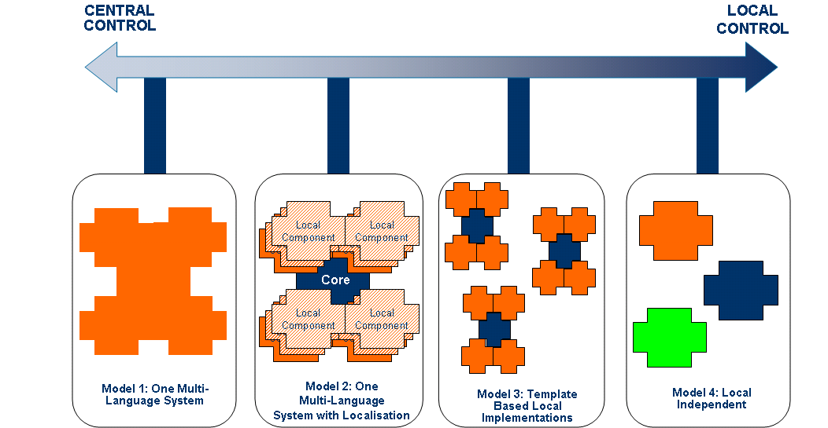
Our Value Propositions (4/4) Our global delivery model balances the need for a centralized deployment of a common “core” system with the need to support local configuration to support specific market needs
Proven Implementation
International Deployment Models

Slide 13



The Accenture Life Insurance Platform Enabling Customers to Achieve their Value Propositions
With the Accenture Life Insurance Platform, Security Benefit Group is able to launch new products in two to six months, including regulatory approvals.
40% decrease in IT operating costs
30% decrease in service costs per policy
35% decrease in IT staff and a 15% decrease in Customer Service staff
With the Accenture Life Insurance Platform, UGF has been able to :
Reduced number of life systems from 4 to 1, utilizing ALIP for all group companies, for all distribution channels (tied agencies, bank, financial advisor), and across individual and group products
Increased operational efficiency and streamlined policy issue and claims settlements by supporting a paperless proposal process and an extensive automation both for distribution channels and Headquarters ;
reduce IT cost of service through “industrializing” the operations engine
Western & Southern has fully automated their new business process.
25% of new business is now jet issued without any human intervention whatsoever. 33% without involving underwriting.
40% of new business is completely issued prior to any paper documentation being received at the home office, slashing turnaround times.
W&SFG has improved speed of commission payments to producers by 500%.
Notes:
13

Slide 14


The Accenture Life Insurance Platform Enabling Customers to Achieve their Value Propositions
Using the Accenture Life Insurance Platform, Prudential achieved its goal of simplification making it “easier for clients and agents to do business with them”.
Prudential has increased the usability, efficiency, and flexibility of the new business process, allowing them to provide high quality service to producers and customers.
Maintainability has been greatly improved as a result of consolidation to a single, comprehensive platform
Replacing multiple legacy new business systems improved IT productivity, and reduced costs
With the Accenture Life Insurance Platform, the client is able to :
Utilize a single and homogenous Life Platform in different European countries that enables the reduction of product time-to-market and an extensive automation both for distribution network and Headquarters
Reduce IT cost of service through “industrializing” the operations engine by 40%
Make IT cost variable and linked to the growth of the business and entry into new markets / countries
Notes:
14

Slide 15
Insurers’ frequently asked questions
Q: Is Accenture really in the software business?
Yes. Accenture has a strong suite of insurance software that includes Claims Components, Policy Components, and the Accenture Life Insurance Platform. These assets are accelerators of transformation for our clients that help differentiate them from the competition. As part of its core strategy, Accenture launched Accenture Software, effective 1st, 2009, in charge of R&D investments, ongoing developments and support of the suite of insurance assets.
Q: How configurable is the Accenture Life Insurance Platform, compared to other policy administration systems?
ALIP is a highly configurable solution. We provide rules-based configuration of products, data capture, business process workflow, underwriting and claim processing. This allows carriers to react quickly to changing conditions by modifying their processes. These changes are performed directly by the end user, without the need for programming.
Q: Can the solution work in all of the various countries in which I operate?
Yes, we have a fully internationalized user interface that can display any language (including double byte). Country-specific rules can be configured in the system.
Q: What technical architecture does the Accenture Life Insurance Platform use?
The Accenture Life Insurance Platform is platform neutral to maximize the insurer’s ability to actively manage the software on the platform of their preference. It also provides high productivity development by using standard tools, making the final code easy to maintain and understand by a large portion of software developers – a requirement for software that typically lasts for decades.

Slide 16
声明：
所有的版权属于原有公司，文件均来自公开渠道
此文件仅供学习使用，任何人不得进行以此为商业目的的行为
如有疑问，请立即删除
学习世界五百强和咨询公司PPT课程请访问如下网站搜索：“司马懿”
百度传课：司马懿PPT学校
网易学堂：司马懿PPT学校
知乎： 司马懿PPT学校
访问地址
https://www.chuanke.com
访问地址
https://study.163.com
访问地址
https://www.zhiu.com

